Slide 1
Parser-X
A Web-Based Mini Compiler and Grammar Analysis Tool for Visualizing Tokens, AST, Symbol Table, and Code Optimization
~ TEAM: CD-VI-T133
Team Members:- Dhruv Tyagi
Shivam Aggarwal Sumedha Acharya

Slide 2
OBJECTIVE
1. To build a simple mini compiler that helps understand how a computer reads and processes code by implementing each stage in practice.
2. To perform lexical, syntax, and semantic analysis to ensure the program is correctly structured and logically valid.
3. To create a user-friendly interface that displays each stage of compilation clearly, providing a practical, step-by-step understanding of how a compiler works.

Slide 3
TECHNOLOGY STACK
C Language → Compiler Engine
Python (Flask) → Backend API Layer
HTML → Structure of UI
CSS → Styling / Look & Feel
JavaScript → Frontend Interaction
JSON → Data Exchange Format
Executable / Subprocess → Connect Python ↔ C Compiler

Slide 4
PROJECT IDEA
1. To develop a simple mini compiler for a custom programming language that demonstrates how code is processed internally through lexical, syntax, and semantic analysis.
2. To provide a step-by-step visualization of the compilation process, helping users connect theory with practical implementation and understand compiler concepts more clearly.

Slide 5
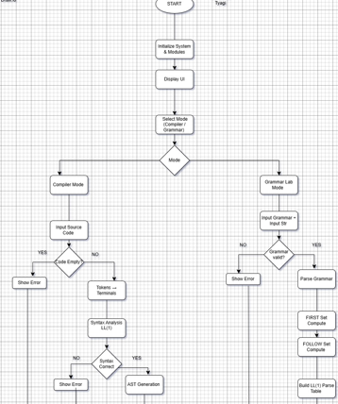
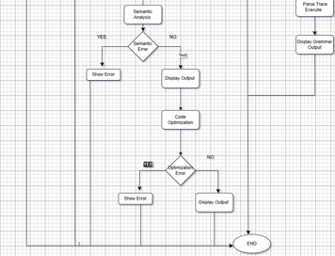
ARCHITECTURE

Slide 6

ROLES AND RESPONSIBILITIES
Dhruv Tyagi
Lexical Analyzer
• Implement token identification using Python and Regex.
• Detect lexical errors and generate token list.
Shivam Aggarwal
Syntax Analyzer
• Design grammar rules and implement the parser.
• Check program structure and detect syntax errors.
Sumedha
Semantic Analyzer & Integration
• Implement type checking and manage the symbol table.
• Detect semantic errors and integrate all modules with testing.

Slide 7
THANK YOU

